Slide 1

An Analysis Of Individual And Community Solar PV Adoption Levels Under Current Regulations Using Agent-based Modelling
Master Thesis Mid-term Presentation
Prakhar Mehta, MEST
Supervisors: Danielle Griego, Alejandro Nuñez-Jimenez
Professor: Dr. Arno Schlüter

Slide 2
Agenda
Introduction and Motivation
Methodology Overview
Communities – “Plots” – in Alt-Wiedikon
Agent-based Modelling and Decision Making
CEA v SFOE data
Next steps
Discussion: inputs and feedback

Slide 3
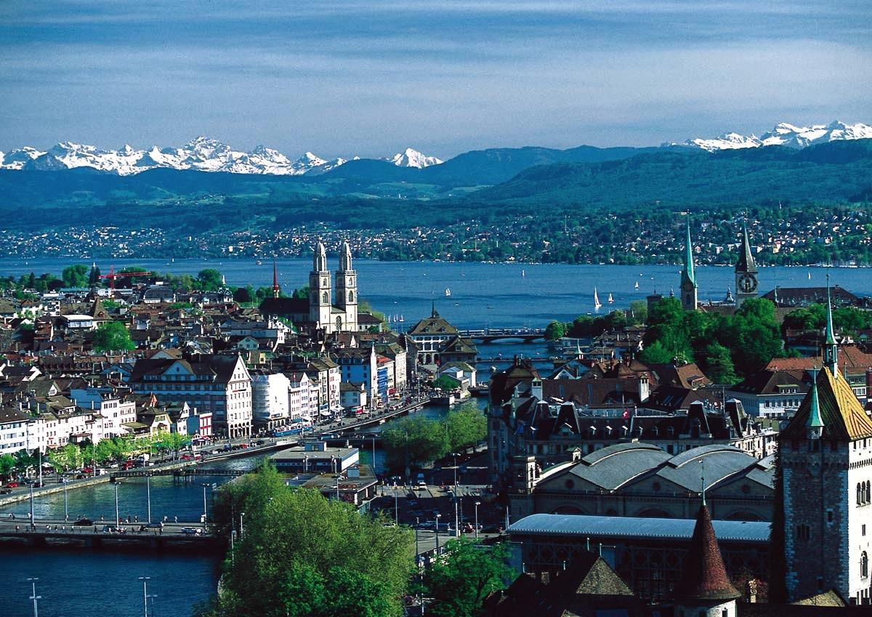

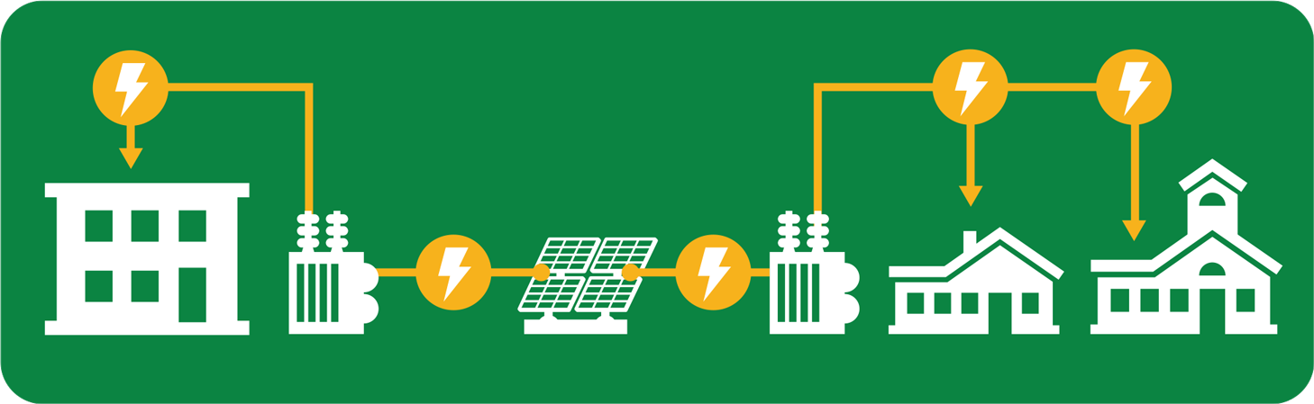


Introduction
2017: 1.4 TWh
2020: 4.4 TWh
2035: 11.4 TWh
Community Scale PV systems
Larger = reduced price/kW
complementary load profiles
Financial benefits/products
Zurich
Great case for community solar
Complementary building types closely packed together
Alt-Wiedikon: high resolution CEA data
Free Icons Library/Flaticon.com/zuerich.com
Notes:
Swiss energy strategy
Community solar
Solar is a solar plant supplying more than one household
Advantages
→ better than individual PV systems
Zurich
Great case
Also regulations…next slide

Slide 4
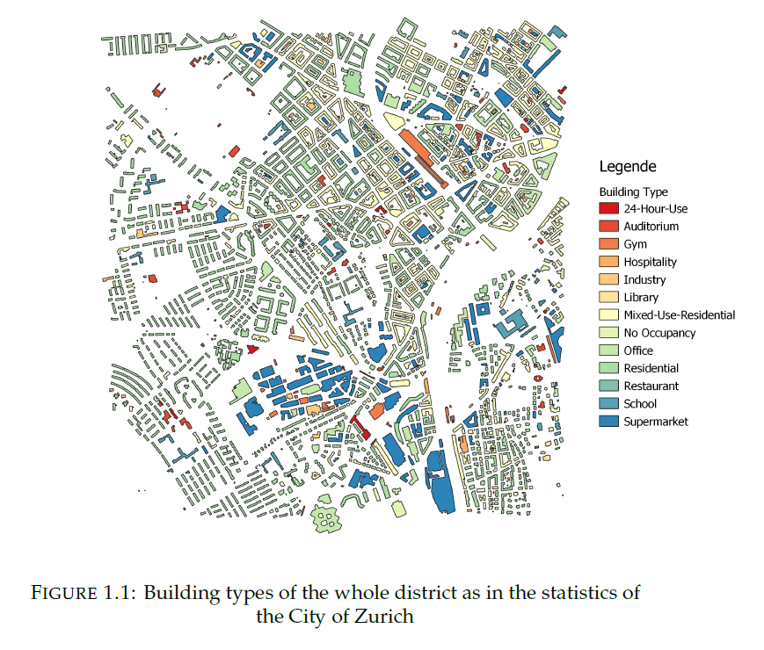
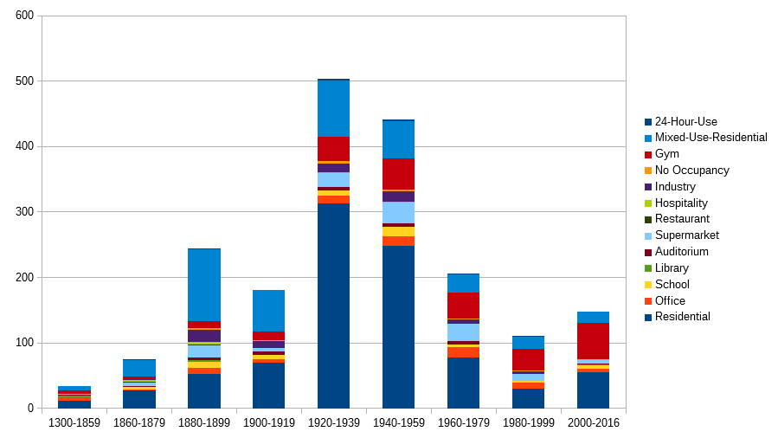
Alt-Wiedikon Buildings Distribution
Years of Construction
Semester Project Report, Sabine Python
Notes:
Diff bldg. types and age

Slide 5
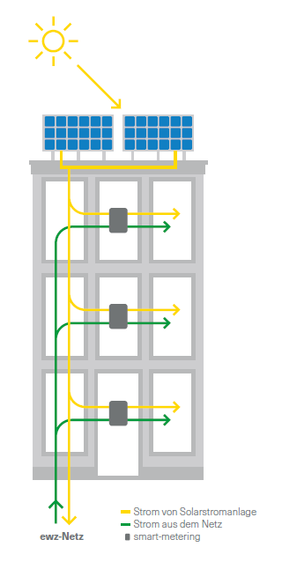
Regulations
Energy Act (EnG 2018):
Mandatory for EWZ: FiT = 7.91Rp./kWh in Zurich
Only one-time subsidy from government: up to 30% of PV system costs
Zusammenschulss für Eigenverbrauch (ZEV) Formation
Article 17, EnG 2018: Incentivizes self consumption communities
multiple consumers → single customer
Building owner/Tenants → form ZEV, share system costs and electricity in premises
EWZ Factsheet Solarsplit
Notes:
Energy act
Aims to contribute to a sufficient, diversified, secure, economical and environmentally sound energy supply.

Slide 6

Need for Solar Adoption + Policy Incentives = Ingredients for a Research Question!
Switzerland needs to increase renewable energy generation by 10 TWh by 2035. Community Solar PV Systems have important advantages over Individual PV systems.
Problem Statement:
Newly introduced regulations incentivize self-consumption and favour Community Solar PV, but their effectiveness remains unknown and un-researched.
Research Questions
Will the adoption of community scale solar PV outpace individually owned solar in the Swiss urban context, given current regulations?
What elements of the current regulation have greater impact on adoption levels?
Level of subsidies
Size of allowed communities

Slide 7
State-of-the-Art
Agent-based models have been used to model solar PV adoption
Individual, heterogenous agents making decisions
Account for irrational human behaviour and how peers/society drive decision making
Rai, Douglas (2016): “Interaction of heterogeneous agents at the micro-level produces macro outcomes” i.e. Emergent behaviour
Icek Ajzen’s Theory of Planned Behaviour (1991) commonly used as the base for decision making
Existing research focuses on individual level PV adoption
Ex-Post: Palm (2017): Surveys of PV adopters –
Active peer effects as a final confirmation from trustworthy sources → Passive peers unimportant
Ex-Ante: Rai, Robinson (2015): Empirical approach to ABM with Relative Agreement algorithms and Small World Networks –
Effect of change in rebate levels on adoption scales with installed base → greater adoption later in the model
No existing research on adoption of community PV systems! ☺
Notes:
Peer effects – effects our peers have on our decisions – if Danielle thinks I should own PV then I value PV higher
Ex-ante
Rai robinson empirical approach
Solar data
Household data
survey of PV adopters - why they decided PV
Relative agreement – opinion and uncertainty of each agent
Interact with other agents based on a SWN model
My model is also somewhat empirically driven…

Slide 8


Methodology Overview
Other Inputs
Peer effects, environmental attitudes, agent locations
Prices – PV and Electricity
Building Data, Geometry, etc.
CEA Model
Alt-Wiedikon, Zurich
(Sabine Python)
CEA Output Data Processing
ABM for
Building Owners
[Individual/Community Adoption]
Results Visualisation
Excel + GIS
Adoption levels Individual v Community
Parameters
Agent Categories based on building type and ownership
Time: Yearly time steps until 2035
Small-world Network: Which agents interact

Slide 9
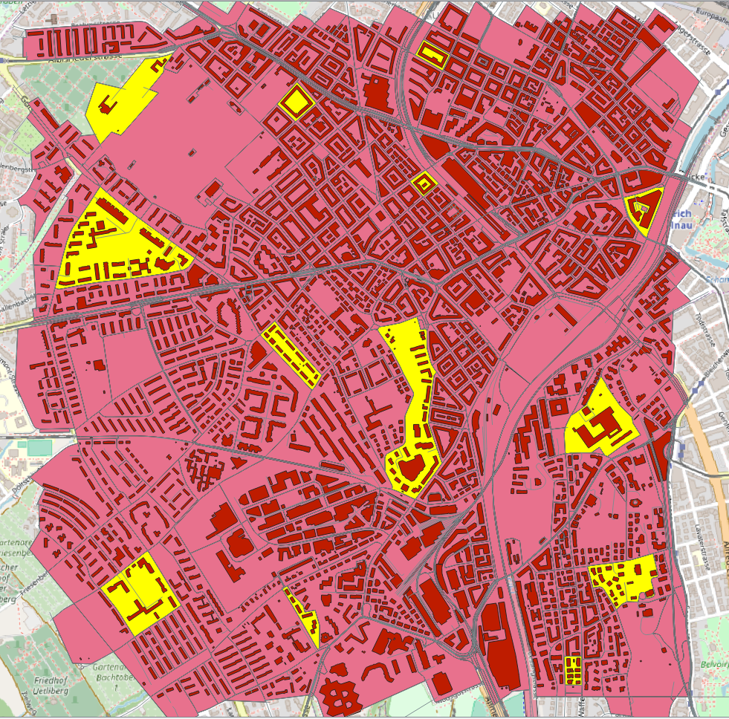
Communities based on Strict ZEV regulations – “Plots”
Make “Plots” very strictly according to regulations
Plots aren’t perfect
Different types of plots formed:
Single/Multiple buildings
Small/Large areas
Different Building types
Notes:
Have to know which communities are possible
Plots – name for possible communities
Make plots: adjacent ; Merger cannot extend over public land and private property
Can't use distribution network and all properties must be connected behind same grid connection point
Plots are not perfect: Removed and added some roads, paths, steps etc; Consulted google maps, openstreet maps
No info about electrical grid points
These plots are still very close to actual plots – can be used for policy suggestions

Slide 10
Zooming into a Plot
All could potentially form a SINGLE community
Or can form multiple SUB-communities
100 MWh Demand self-imposed limit – threshold for wholesale electricity market participation – discussion later
→ Buildings which can actually form a ZEV are further classified into sub-plots
100 MWh
Notes:
Still very big plots
Buildings can form sub plots – I will tell you why in the next slide
100 MWh is self imposed as otherwise you compete with wholesale electricvity prices
100 MWh = 25-30 households = 3-4 typical Swiss residential buildings anyway

Slide 11

What does our ABM do?
Building owners of different types
DECISIONS:
Solar NO
Solar YES
Individual
Community
What size of community? With who?
Individual PV on building – no problems
Size of system known – prices known
2 choices only – “Ja” oder “Nein”
Community PV in a plot – lots of problems!
PV System Size ←→ Costs ←→ Members of ZEV
Keep Community PV Size varying
Avoids Bias
Hence use combinatorics – each subplot (100 MWh) will decide out of many options after buildings get an idea to adopt/not adopt solar
Notes:
Keep Community PV Size varying depending on how many join as the economics of the Community change with more/less than anticipated members
Avoids bias: If I fix community size and then use that NPV to run ABM it might always be beneficial and if some building says NO, then the whole NPV calculation is incorrect and needs to be re-evaluated
Avoids bias – not fixing the subplots to a particular size = max.
Now it can be even smaller steps

Slide 12
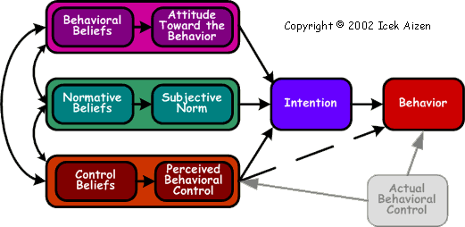
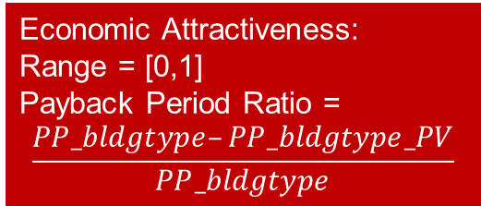
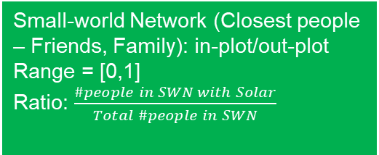
Use of Theory of Planned Behaviour for decision making Stage I – Idea Generation
Environmental attitudes/beliefs Range = [0,1]
w/ MINERGIE = high EA ~1
w/o MINERGIE = low EA ~0
$$Intention= Σ weight∗var>threshold$$
IDEA Generation
Do I want solar?
Yes/No
Variables
Small-world Network (Closest people – Friends, Family): in-plot/out-plot
Range = [0,1]
Ratio: $\frac{\#people in SWN with Solar}{Total \#people in SWN}$
Economic Attractiveness:
Range = [0,1]
Payback Period Ratio =
$$\frac{PP_bldgtype–PP_bldgtype_PV}{PP_bldgtype}$$
Icek Ajzen, ‘Constructing a TPB Questionnaire: Conceptual and Methodological Considerations’, 2002
Notes:
TPB has 2 stages – intention, and behaviour
Subjective norms – what does society think
PBC - Does agent feel confident enough to do it?
PP = how quickly does the investment pay off compared to other investments
Need to quantify these qualitative ideas
First, let us try to quantify the intention, Forget about the behaviour for now

Slide 13
Use of Theory of Planned Behaviour for decision making Stage II – Choice
Environmental attitudes/beliefs Range = [0,1]
w/ MINERGIE = high EA ~1
w/o MINERGIE = low EA ~0
Choice:
Individual OR Community based on NPV ranking
Small-world Network (Closest people – Friends, Family): in-plot/out-plot
Range = [0,1]
Ratio: $\frac{\#people in SWN with Solar}{Total \#people in SWN}$
Economic Attractiveness:
Range = [0,1]
Payback Period Ratio =
$$\frac{PP_bldgtype–PP_bldgtype_PV}{PP_bldgtype}$$
NPV
Icek Ajzen, ‘Constructing a TPB Questionnaire: Conceptual and Methodological Considerations’, 2002
Notes:
NPV
Not used for intention but used as PBC for intention to behaviour
In intention there is the problem of multiple NPVs for different community sizing

Slide 14
Choice based on NPV Ranking
After clearing Stage I: Only subplot considered
A, B, C, D
11 possible communities
ABCD
ABC
BCD
…
Which community is formed?

Slide 15
Who prefers what? Let’s rank preferences:
Lower the sum of NPV rankings, more preferred the community
Other criteria, like self-sufficiency of communities formed, can also be ranked and weighted together
Combinations | Ranking A | Ranking B | Ranking C | Ranking D | SUM | Overall Rank | Comments
ABCD | 1 | 1 | 2 | 1 | 5 | 1 | C compromises
ABC | 2 | 3 | 3 | - | 8 | 3
CDA | 3 | - | 4 | 4 | 11 | 4
ABD | 4 | 4 | - | 3 | 11 | 4
BCD | - | 2 | 1 | 2 | 5 | 2
AB | 5 | 5 | - | - | 10 | 6 | 3 member ZEV prioritized over 2 member
BC | - | 6 | 5 | - | 11 | 7

Slide 16
Base Case ABM
Base Case: Adoption under current regulations until 2035 To what degree do current regulations lead to the Energy Strategy 2050 goals?
Assumptions:
PV size = Max. roof area available
Community formation = strict ZEV + max. 100 MWh demand/year
Policy = Current regulations
Variables changing with time:
Falling PV prices (projections), peer effects
Expected Results
Community > Individual adoption
Adoption increases towards the end of simulation period as peer effects increase and PV prices decrease

Slide 17
Interesting Scenarios – change Base Case Assumptions
Reduced PV sizes
Maybe demands are not high enough for larger PV systems
Can show us optimum size levels in terms of technical and economic aspects
Relaxed ZEV regulations
Bigger Plots/Subplots
No 100 MWh demand criteria
Can show if better and larger communities can be formed at possibly lower costs
Changing Subsidies and FiTs
Prolong availability after 2030,Increase/Decrease/Special ZEV credit
Gives an idea of the importance of the level and type of subsidies

Slide 18

SFOE v CEA Data Fits well but magnitude of difference is high!
Rsquared = 0.933
Notes:
Issues with comparison
Different solar radiations per m2 – in general, CEA > SFOE
Different roof areas!
Min difference = -3458 m2
Max difference = +1898 m2
CEA has no inclination/tilt data
Combined buildings data together to compare

Slide 19

Median difference = 10 MWh = approx. 3 households’ yearly demand! CEA underestimates.
SFOE – CEA | MWh
Min | -685.87
Q1 | 3.739385
Median | 10.72338
Q3 | 18.63956
Max | 185.7438
Still use CEA:
Hourly data important for SCR and SS calculations!
Notes:
Possible reasons for underestimation:
CEA areas are smaller due to projections
Actual roofs with inclination and tilt simulation get more radiation
Possible errors in comparison: Buildings → Zones are biggest sources of error
Roof tilts etc not considered

Slide 20
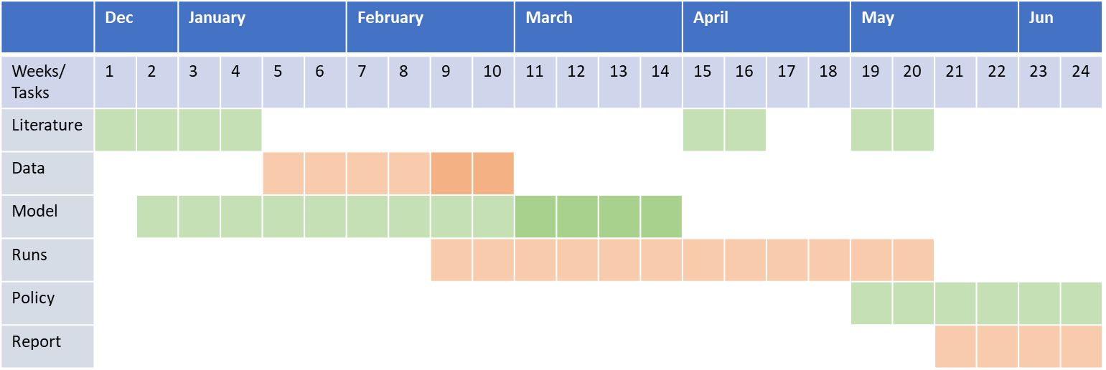
Next Steps
March: ABM model architecture
April: ABM Runs
May: ABM results analysis
June: Final Presentation
September: CISBAT Conference Poster Presentation!
Mid-term PPT

Slide 21

Thank You! Time for questions and discussion! ☺

Slide 22
Discussion: inputs and feedback
100 MWh self-imposed limit
~25-30 households ~ 4-5 typical residential buildings
Dsregard this limit and consider PV comparison with wholesale prices? NPV changes!
NPV not considered in Stage I
TPB becomes complex with various options (else had to fix community size, unrealistic)
But, any other way than PP ratios to develop economic attractiveness?
Does considering NPV ranking in Stage II make sense?
Conflict resolution:
Based on technical criteria, like greater self-sufficiency?
Based on best NPV situation for all buildings concerned?
Based on inclusion – include as many buildings in community system?
Include feedback to Stage I to model it as persuasion from peers?
Any thoughts on the decision making process?
What scenarios do you like? – reduced PV, relaxed regulations, changing subsidies, Others?
Notes:
100 MWh criteria
Wholesale prices can be lower than what consumers pay or even higher – depends.
Can have greater advantages if participate in the wholesale market because of low electricity prices so solar may not be needed at all – can compare base case with a scenario in which wholesale prices are considered and one in which the 100 MWh limit is disregarded and any size is allowed…
If a building does not want solar at all:
Ignore it from all communities
Feedback: Go back to Stage I (idea generation) with increased peer effects as others try to motivate it to buy solar?

Slide 23
Back-up Slides

Slide 24
My case: So. Many. Variables!
Environmental attitudes/beliefs Technical aspects
Economics
Past opinions
Cost effectiveness
No. of installations in neighbourhood
Feedback based on peer decisions
What Peers Say
General Social Image of PV
Small-world Network (Closest people – Friends, Family)
Does agent feel confident enough to do it?
Money/Economic Attractiveness
Time
Skills
Support and Persuasion
Notes:
What can be included in attitude toward the behaviour
What forms subjective norms
What forms PBC

